Slide 1
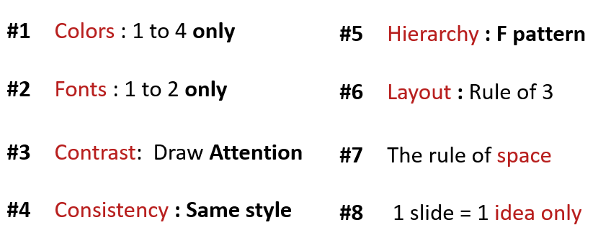
ACTIVITY 2
Analyze the problems on the slides
What is not useful ?
Which rule is not valid?
Improve the slides to fix the problem

Slide 2
Quiz-app G-7
MSK
AGENDA
1. THE SELLER
KEA NHOR
2. THE TECH
SOPHAL SARARN
3. THE MANAGER
MENG MAO

Slide 3

Quiz-app G-7
MSK
3 What your team need to improve?
Improve communication & time management
Improve researching skills & responsibility
Improve discussing & solidarity
The Manager

Slide 4
The design is:
Colors : just has only 4 color in the design it’s good
Fonts : use a lot of font family style, so bed.
Contrast : All the slide has the contrast with no important think so it look bad.
consistency : for this design it’s no repeatetion (sam style is very messy).
Hirearchy : I think it’s no better for F paterm because it not easy to read.
Layout : for the layout is so bad .
The rule of space : It ok for rule of space too.
1 slide 1 idea : it look so messy with the idea that the slide want to descript so it’s no better.

